Slide 1

Topic 2: Market power
Industrial Organisation / Matěj Bajgar

Slide 2
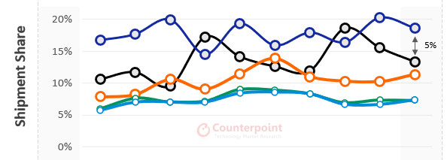
Global handset market: shipments
https://www.counterpointresearch.com/global-handset-market-operating-profits-q2-2022/

Slide 3
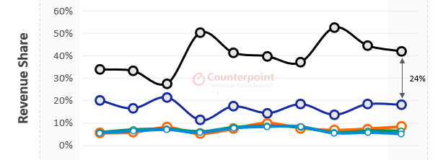
Global handset market: revenues
https://www.counterpointresearch.com/global-handset-market-operating-profits-q2-2022/

Slide 4
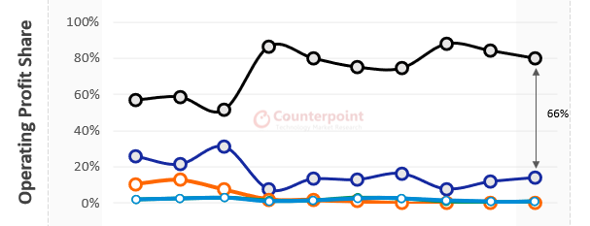
Global handset market: operating profits
https://www.counterpointresearch.com/global-handset-market-operating-profits-q2-2022/

Slide 5

Why does Apple generate so much more profits and revenues from a similar amount of shipments?
Which assets or characteristics allows Apple to do that?

Slide 6
Topic outline
What is market power?
How is it related to market structure
What are its sources?
How can we measure it?
Is it on the rise?

Slide 7

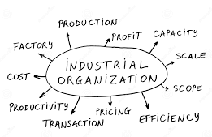

What’s in it for me?

Slide 8
What is market power?
How is it related to market structure
What are its sources?
How can we measure it?
Is it on the rise?

Slide 9
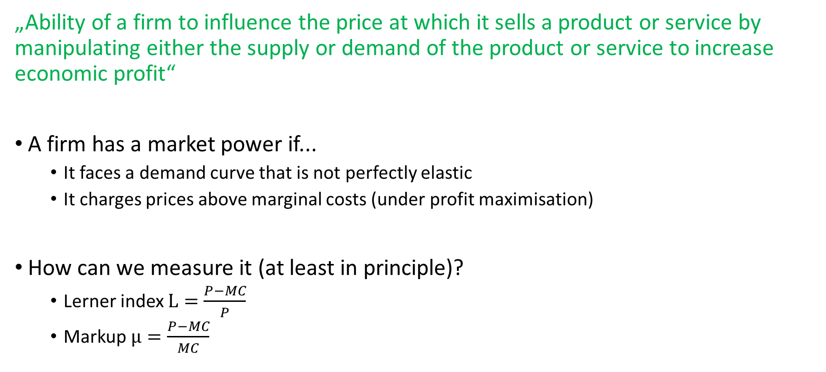
What is market power?
„Ability of a firm to influence the price at which it sells a product or service by manipulating either the supply or demand of the product or service to increase economic profit“
A firm has a market power if...
It faces a demand curve that is not perfectly elastic
It charges prices above marginal costs (under profit maximisation)
How can we measure it (at least in principle)?
Lerner index $L=\frac{P−MC}{P}$
Markup $μ=\frac{P−MC}{MC}$
Notes:
L and $μ$ basically the same thing, L more traditional, lately people talk more about $μ$

Slide 10
What is market power?
How is it related to market structure
What are its sources?
How can we measure it?
Is it on the rise?

Slide 11
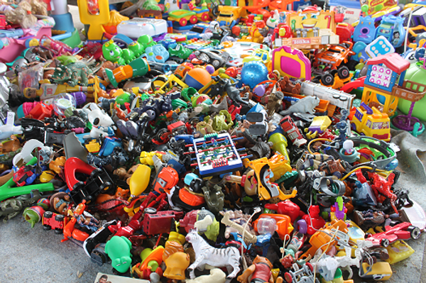
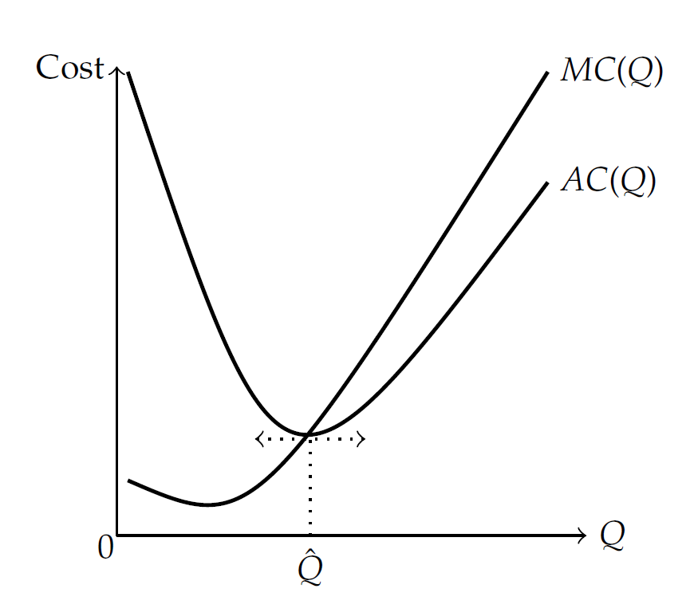
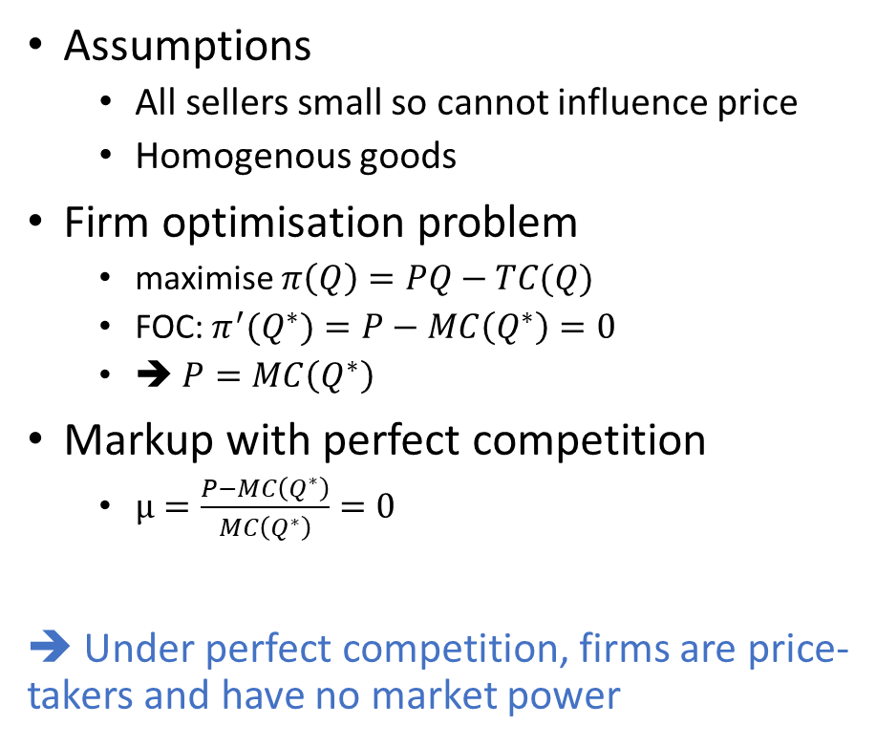
Market power with perfect competition
Assumptions
All sellers small so cannot influence price
Homogenous goods
Firm optimisation problem
maximise $π\left(Q\right)=PQ−TC(Q)$
FOC: $π^{′}(Q^{∗})=P−MC\left(Q^{∗}\right)=0$
➔ $P=MC\left(Q^{∗}\right)$
Markup with perfect competition
$μ=\frac{P−MC\left(Q^{∗}\right)}{MC\left(Q^{∗}\right)}=0$
➔ Under perfect competition, firms are price-takers and have no market power
firm-level supply curve
P
perfectly elastic demand curve

Slide 12

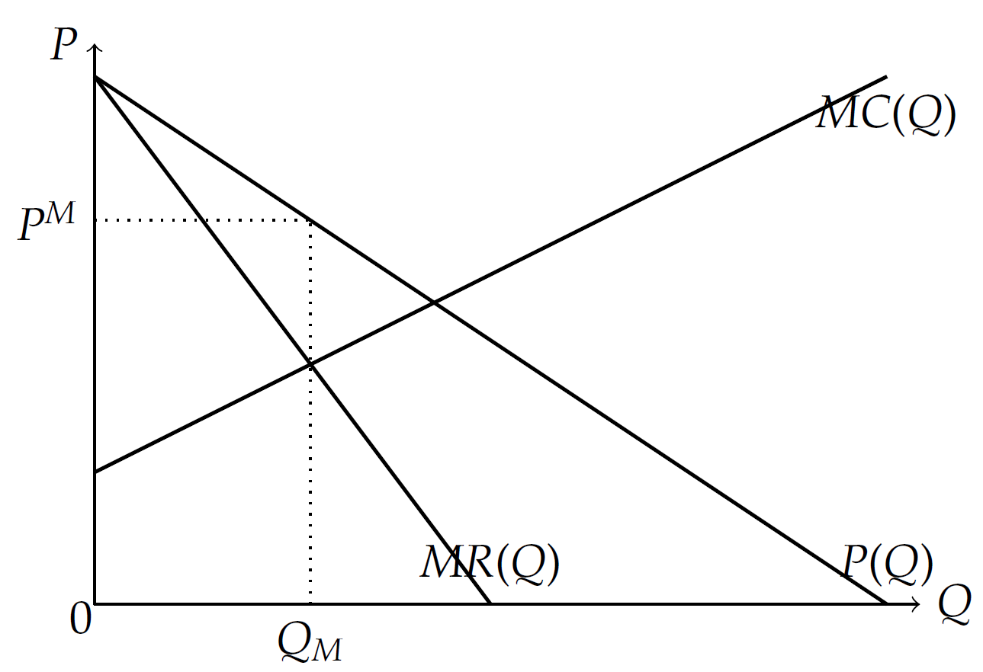
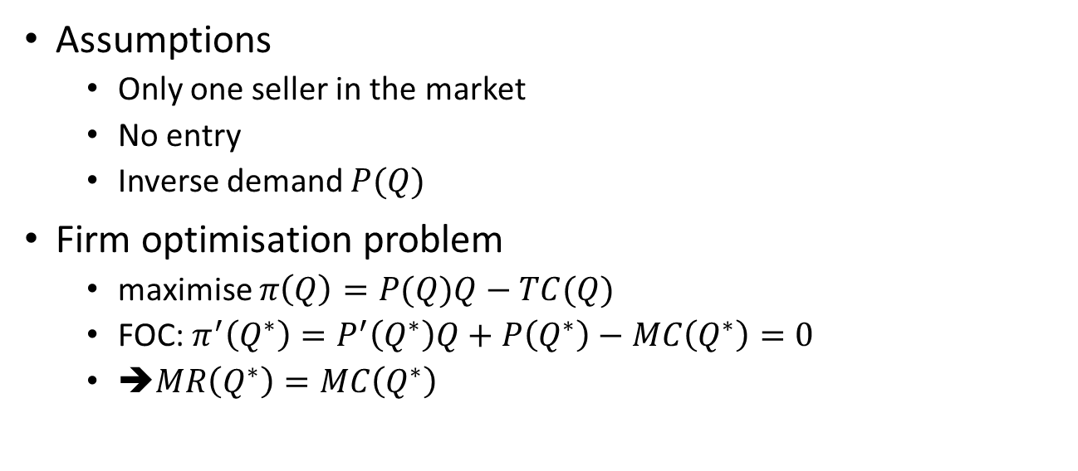
Market power with monopoly
Assumptions
Only one seller in the market
No entry
Inverse demand $P(Q)$
Firm optimisation problem
maximise $π\left(Q\right)=P(Q)Q−TC(Q)$
FOC: $π^{′}\left(Q^{∗}\right)=P^{′}\left(Q^{∗}\right)Q+P\left(Q^{∗}\right)−MC\left(Q^{∗}\right)=0$
➔$MR\left(Q^{∗}\right)=MC\left(Q^{∗}\right)$
downward-sloping demand curve

Slide 13
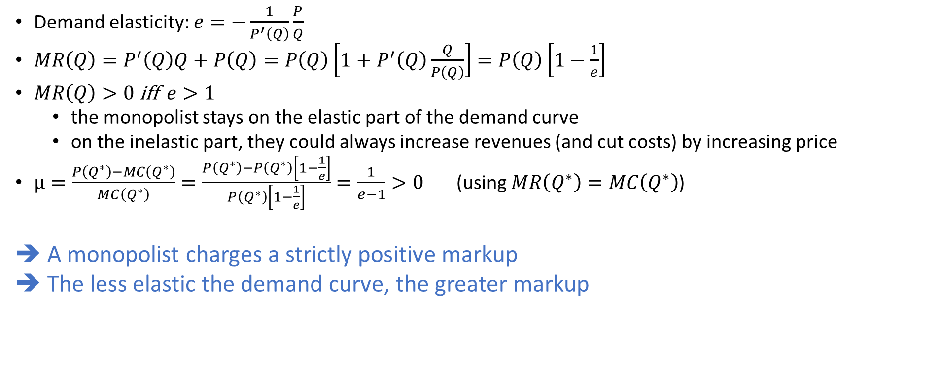
Market power with monopoly
Demand elasticity: $e=−\frac{1}{P^{′}\left(Q\right)}\frac{P}{Q}$
$MR\left(Q\right)=P^{′}\left(Q\right)Q+P\left(Q\right)=P\left(Q\right)\left[1+P^{′}\left(Q\right)\frac{Q}{P\left(Q\right)}\right]=P\left(Q\right)\left[1−\frac{1}{e}\right]$
$MR\left(Q\right)>0$ iff $e>1$
the monopolist stays on the elastic part of the demand curve
on the inelastic part, they could always increase revenues (and cut costs) by increasing price
$μ=\frac{P\left(Q^{∗}\right)−MC\left(Q^{∗}\right)}{MC\left(Q^{∗}\right)}=\frac{P\left(Q^{∗}\right)−P\left(Q^{∗}\right)\left[1−\frac{1}{e}\right]}{P\left(Q^{∗}\right)\left[1−\frac{1}{e}\right]}=\frac{1}{e−1}>0$ (using $MR\left(Q^{∗}\right)=MC\left(Q^{∗}\right)$)
➔ A monopolist charges a strictly positive markup
➔ The less elastic the demand curve, the greater markup

Slide 14
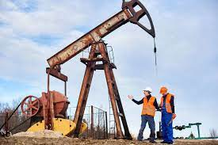
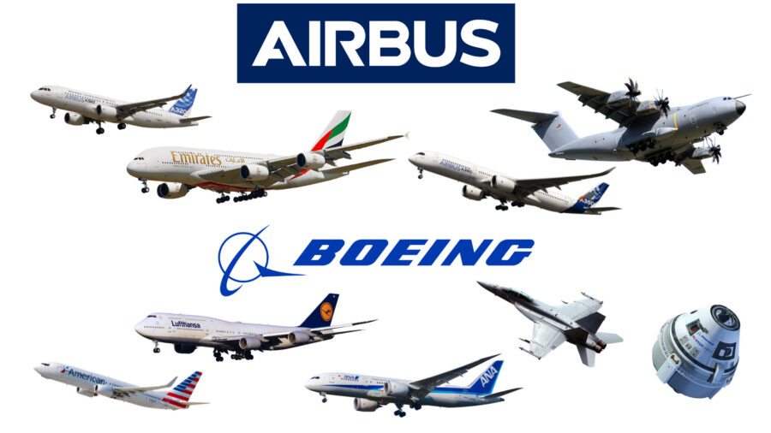
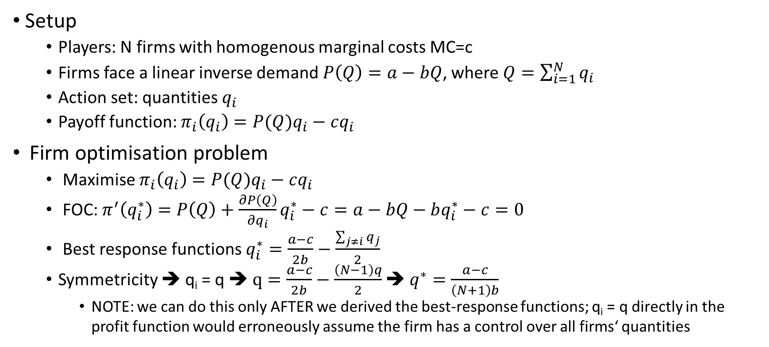
Market power with oligopoly: Cournot
Setup
Players: N firms with homogenous marginal costs MC=c
Firms face a linear inverse demand $P\left(Q\right)=a−bQ$, where $Q=\sum_{i=1}^{N}{q_{i}}$
Action set: quantities $q_{i}$
Payoff function: $π_{i}\left(q_{i}\right)=P(Q)q_{i}−cq_{i}$
Firm optimisation problem
Maximise $π_{i}\left(q_{i}\right)=P(Q)q_{i}−cq_{i}$
FOC: $π^{′}\left(q_{i}^{∗}\right)=P\left(Q\right)+\frac{∂P\left(Q\right)}{∂q_{i}}q_{i}^{∗}−c=a−bQ−bq_{i}^{∗}−c=0$
Best response functions $q_{i}^{∗}=\frac{a−c}{2b}−\frac{\sum_{j≠i}{q_{j}}}{2}$
Symmetricity ➔ q_{i} = q ➔ $q=\frac{a−c}{2b}−\frac{\left(N−1\right)q}{2}$ ➔ $q^{∗}=\frac{a−c}{\left(N+1\right)b}$
NOTE: we can do this only AFTER we derived the best-response functions; q_{i} = q directly in the profit function would erroneously assume the firm has a control over all firms‘ quantities

Slide 15
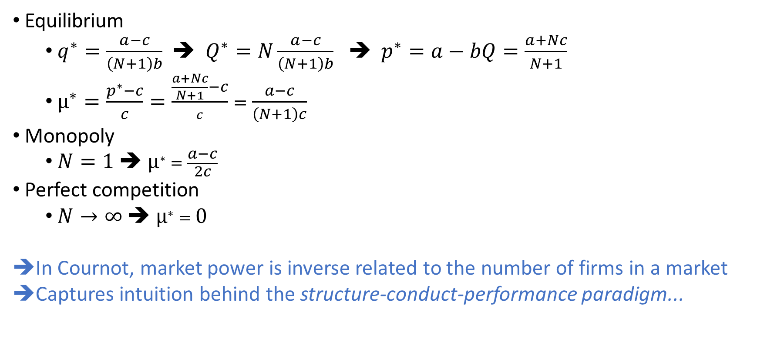
Market power with oligopoly: Cournot
Equilibrium
$q^{∗}=\frac{a−c}{\left(N+1\right)b}$ ➔ $Q^{∗}=N\frac{a−c}{\left(N+1\right)b}$ ➔ $p^{∗}=a−bQ=\frac{a+Nc}{N+1}$
$μ^{∗}=\frac{p^{∗}−c}{c}=\frac{\frac{a+Nc}{N+1}−c}{c}=\frac{a−c}{\left(N+1\right)c}$
Monopoly
$N=1$ ➔ $μ^{∗}=\frac{a−c}{2c}$
Perfect competition
$N→∞$ ➔ $μ^{∗}=0$
In Cournot, market power is inverse related to the number of firms in a market
Captures intuition behind the structure-conduct-performance paradigm...

Slide 16
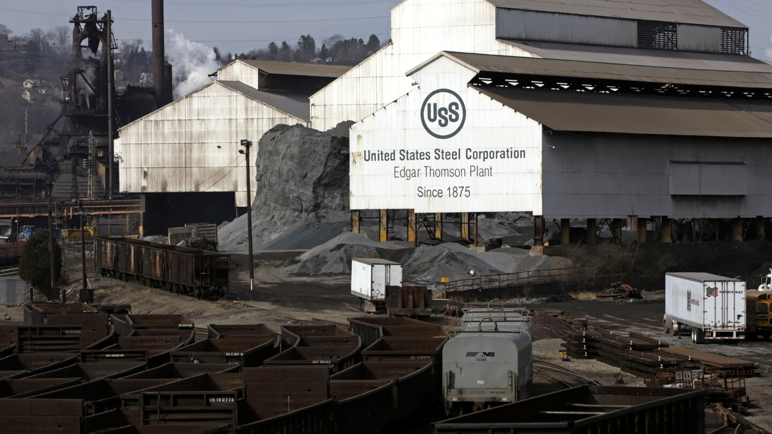
Structure-conduct-performance
In 1920, US Steel held 70% share in the American steel production
But „United States v. United States Steel Corporation“ found
Sherman Antitrust Act against anticompetitive behavior and unfair business practices, rather than solely targeting companies for their large size
no evidence that U.S. Steel had engaged in anticompetitive practices that would harm competition or consumers.
➔ Precedent that being big or having a dominant market share does not automatically constitute an antitrust violation.
➔ Need for a more nuanced understanding of market structure, behavior of firms, and their implications for competition and consumer welfare ➔ Birth of IO

Slide 17
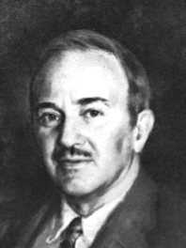
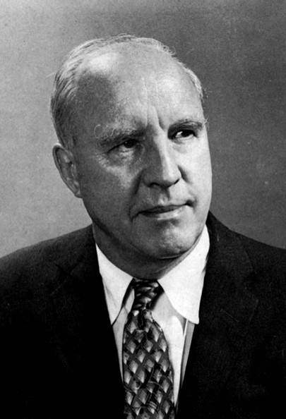
Structure-conduct-performance
Harvard school (Edward Chamberlin, Edward Mason)
Tried to infer from market structure how competitive a market is
Structure (e.g. market shares)
Conduct (e.g. prices, investments)
Performance (e.g. profits, consumer surplus, social welfare)
Assumed that markets lie on a spectrum from perfect competition to a monopoly
➔ In line with the intuition of the Cournot model
Empirical evidence
Initial findings supportive of correlation between, e.g., concentration and profit
But later evidence inconclusive

Slide 18
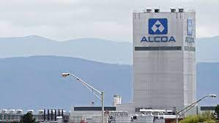
Structure-conduct-performance
Influence on anti-trust
United States v. Aluminum Company of America (1945)
Alcoa had 90% market share in US aluminium
Accused that it had unlawfully monopolized the aluminum industry
The government argued that Alcoa's dominance stifled competition, restricted entry and harmed consumers through higher prices and reduced innovation.
Court found Alcoa's dominance violated Sherman Antitrust Act (in contrast with the US Steel case)
➔ Precedent demonstrating the government's willingness to challenge and regulate monopolistic practices
➔ 1945-1960 – stringent anti-trust based on SCP doctrine

Slide 19
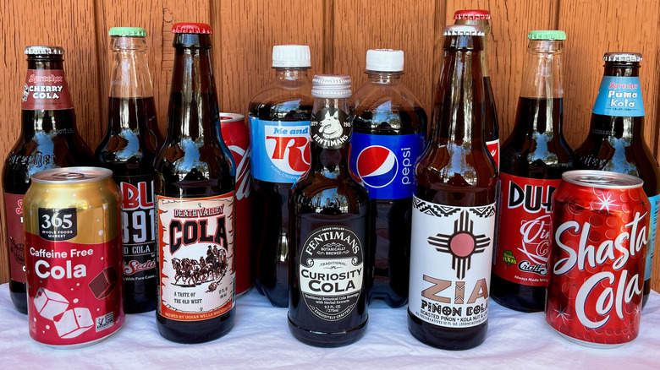
Measuring structure: market concentration
How can we measure market structure?
In the Cournot model, we used just the number of competitors = N
Makes sense if the firms are of similar size (in our model, all were the same size)
But in many markets, a few dominant players and many small ones ➔ N not informative
Market concentration
Trying to capture, in one number, to what extent the market shares are skewed towards a few largest competitors
At the heart of the Structure-Conduct-Performance paradigm
An important role in anti-trust decisions
There are many ways of measuring concentration ➔ can give different results

Slide 20
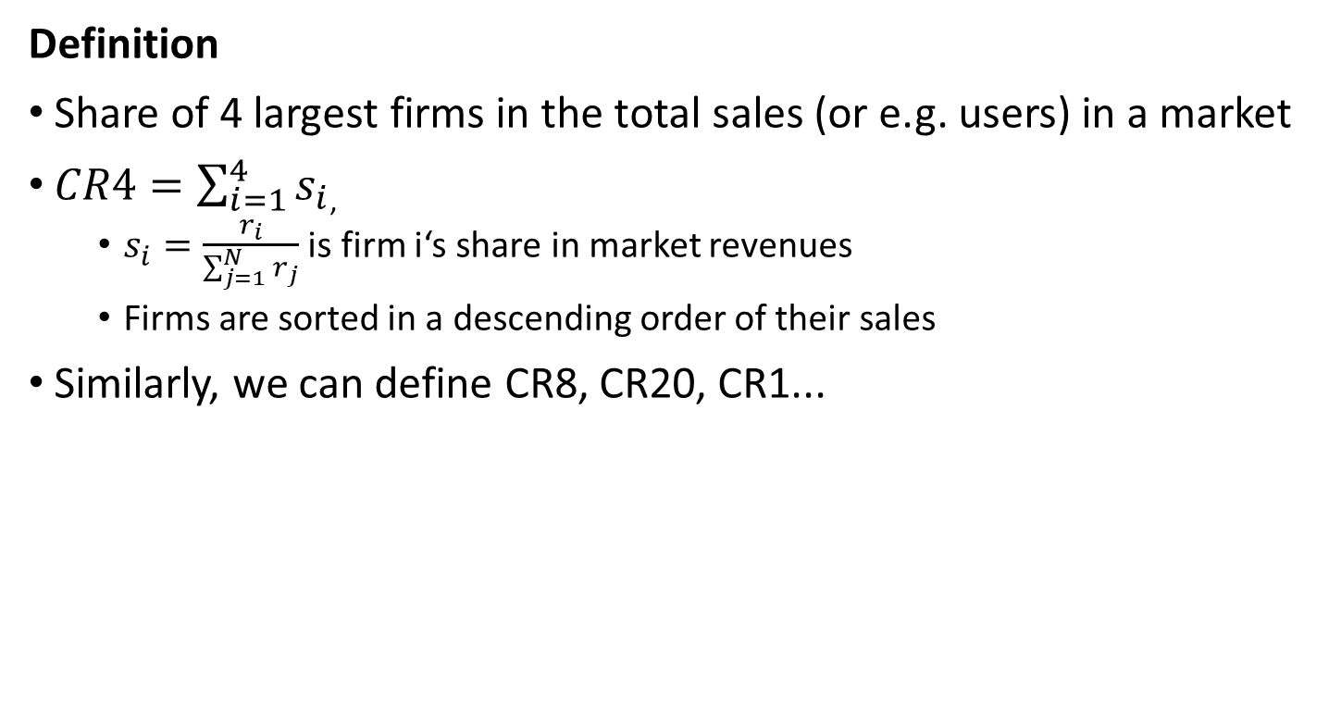
Measuring market concentration: Measure 1: CR4
Definition
Share of 4 largest firms in the total sales (or e.g. users) in a market
$CR4=\sum_{i=1}^{4}{s_{i}}$,
$s_{i}=\frac{r_{i}}{\sum_{j=1}^{N}{r_{j}}}$ is firm i‘s share in market revenues
Firms are sorted in a descending order of their sales
Similarly, we can define CR8, CR20, CR1...

Slide 21
Measuring market concentration: Measure 1: CR4
Most popular social networks worldwide (2022), ranked by number of monthly active users (MAU)
Rank | Social network | MAU | Share | Group
1 | Facebook | 2895 | 18% | 46%
2 | YouTube | 2291 | 14% | 14%
3 | WhatsApp | 2000 | 12%
4 | Instagram | 1393 | 9%
5 | Messenger | 1300 | 8%
6 | WeChat | 1251 | 8% | 11%
7 | TikTok | 1000 | 6% | 10%
8 | Douyin | 600 | 4%
9 | QQ | 591 | 4%
10 | Weibo | 566 | 3% | 3%
11 | Telegram | 550 | 3% | 3%
12 | Snapchat | 538 | 3% | 3%
13 | Kuaishou | 506 | 3% | 3%
14 | Pinterest | 454 | 3% | 3%
15 | Twitter | 436 | 3% | 3%
Example
Global shares of social networks in MAU
CR4=52%, CR8=78% and CR1=18%
?
?
?
https://www.statista.com/statistics/272014/global-social-networks-ranked-by-number-of-users/

Slide 22
Measuring market concentration: Measure 1: CR4
Pros and Cons
Advantages
Simple, intuitive and widely used
Disadvantages
Does not capture variation among top 4
E.g. CR8 would be the same if Facebook had 50% and the next 7 networks had 4%!)
Does not capture variation outside of the top 4
CR1/4/8/20 can give different ranking of industries in terms of concentration

Slide 23
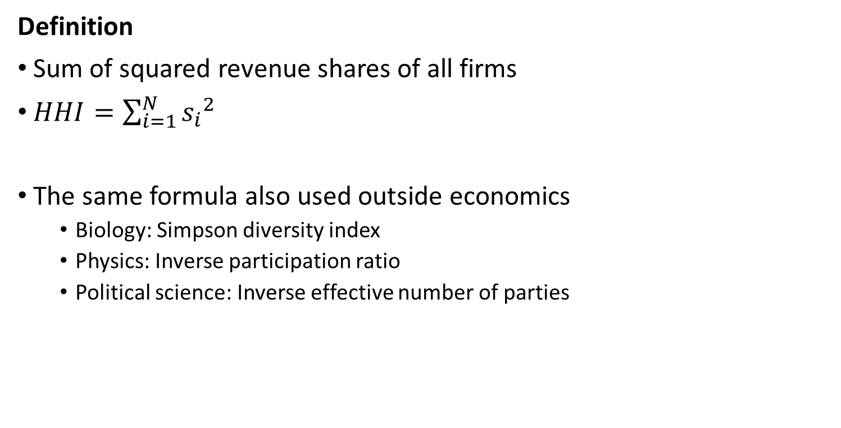
Measuring market concentration: Measure 2: Hirschman-Herfindahl Index
Definition
Sum of squared revenue shares of all firms
$HHI=\sum_{i=1}^{N}{{s_{i}}^{2}}$
The same formula also used outside economics
Biology: Simpson diversity index
Physics: Inverse participation ratio
Political science: Inverse effective number of parties

Slide 24
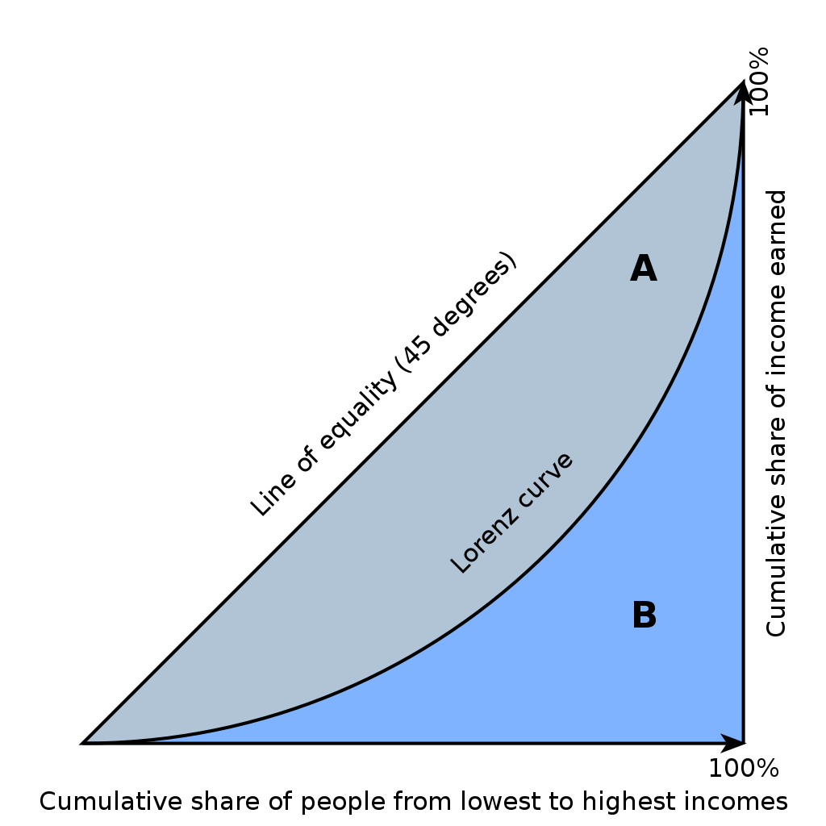
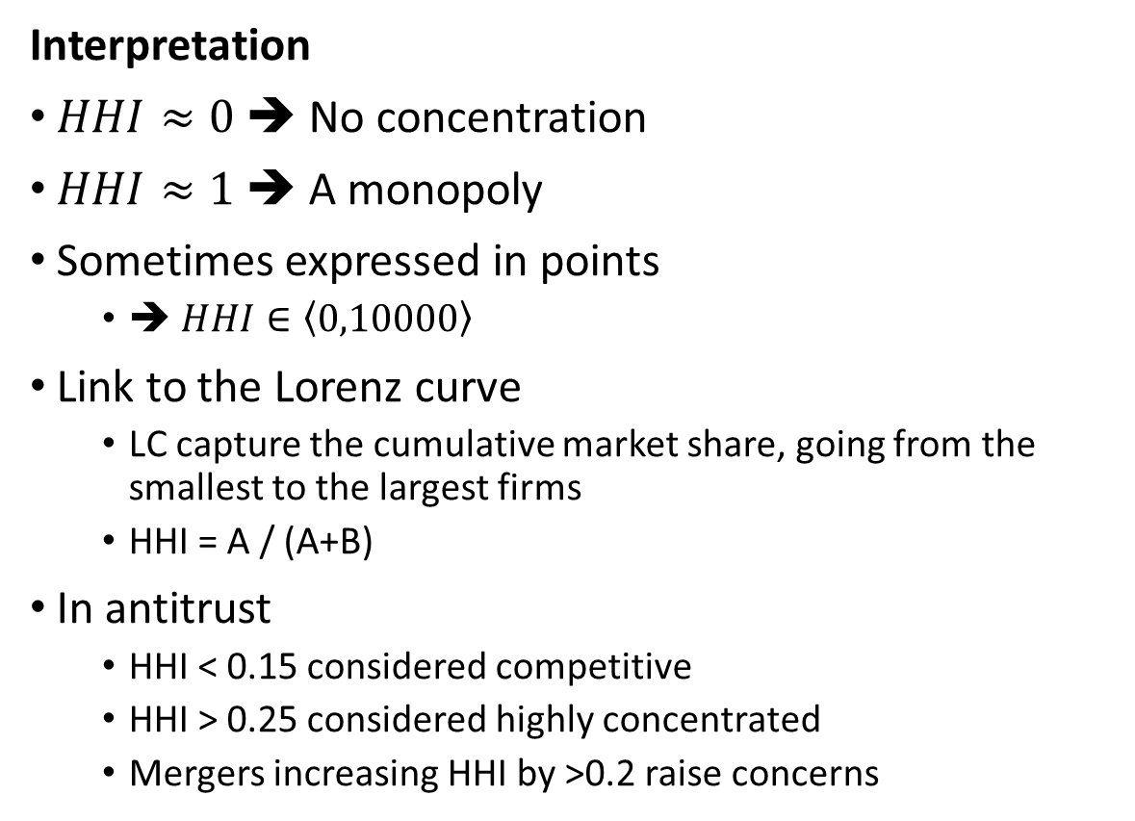
Measuring market concentration: Measure 2: Hirschman-Herfindahl Index
Interpretation
$HHI≈0$ ➔ No concentration
$HHI≈1$ ➔ A monopoly
Sometimes expressed in points
➔ $HHI∈\left\langle 0,10000\right\rangle$
Link to the Lorenz curve
LC capture the cumulative market share, going from the smallest to the largest firms
HHI = A / (A+B)
In antitrust
HHI < 0.15 considered competitive
HHI > 0.25 considered highly concentrated
Mergers increasing HHI by >0.2 raise concerns

Slide 25
Measuring market concentration: Measure 2: Hirschman-Herfindahl Index
Most popular social networks worldwide (2022), ranked by number of monthly active users (MAU)
Rank | Social network | MAU | Share | Group
1 | Facebook | 2895 | 18% | 46%
2 | YouTube | 2291 | 14% | 14%
3 | WhatsApp | 2000 | 12%
4 | Instagram | 1393 | 9%
5 | Messenger | 1300 | 8%
6 | WeChat | 1251 | 8% | 11%
7 | TikTok | 1000 | 6% | 10%
8 | Douyin | 600 | 4%
9 | QQ | 591 | 4%
10 | Weibo | 566 | 3% | 3%
11 | Telegram | 550 | 3% | 3%
12 | Snapchat | 538 | 3% | 3%
13 | Kuaishou | 506 | 3% | 3%
14 | Pinterest | 454 | 3% | 3%
15 | Twitter | 436 | 3% | 3%
Example
Global shares of social networks in MAU
HHI=0.10
?
https://www.statista.com/statistics/272014/global-social-networks-ranked-by-number-of-users/

Slide 26
Measuring market concentration: Measure 2: Hirschman-Herfindahl Index
Pros and Cons
Advantages
Describes the entire distribution
Disadvantages
Less intuitive that CR4
Requires data on all firms in the market
➔ Sometimes calculated based only on the larger firms
Very different distributions of market shares can lead to the same HHI
A distribution is never perfectly described by a single number
Similar issues in literature on measuring income inequality

Slide 27

Measuring market concentration: What is a market?
Most popular social networks worldwide (2022), ranked by number of monthly active users (MAU)
Rank | Social network | MAU | Share | Group
1 | Facebook | 2895 | 18% | 46%
2 | YouTube | 2291 | 14% | 14%
3 | WhatsApp | 2000 | 12%
4 | Instagram | 1393 | 9%
5 | Messenger | 1300 | 8%
6 | WeChat | 1251 | 8% | 11%
7 | TikTok | 1000 | 6% | 10%
8 | Douyin | 600 | 4%
9 | QQ | 591 | 4%
10 | Weibo | 566 | 3% | 3%
11 | Telegram | 550 | 3% | 3%
12 | Snapchat | 538 | 3% | 3%
13 | Kuaishou | 506 | 3% | 3%
14 | Pinterest | 454 | 3% | 3%
15 | Twitter | 436 | 3% | 3%
What are the issues with these market shares?
Is YouTube in the same market as Whatsapp?
Is global the relevant market? Some of the networks are regional. Should the shares be calculated within Europe? Or nationally?
Is number of active users a relevant measure?
In most contexts, revenues are the preferred measure of market share
But when network effects important, number of users is very relevant (Facebook paid $19B for WhatsApp when it had $10M of revenues and 55 employees)
New rule in Germany: pre-merger notification thresholds taking into account transaction value
The market shares do not take into account ownership (4 out of top 5 part of Meta!!)
Taking ownership into account increases CR4 to 81% and HHI to 0.26!!
https://www.statista.com/statistics/272014/global-social-networks-ranked-by-number-of-users/

Slide 28

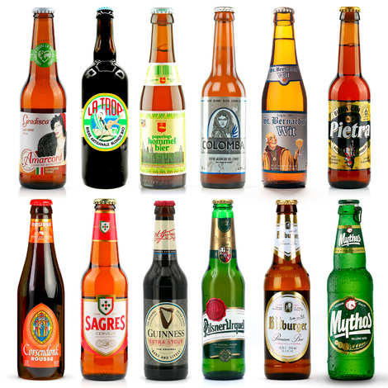
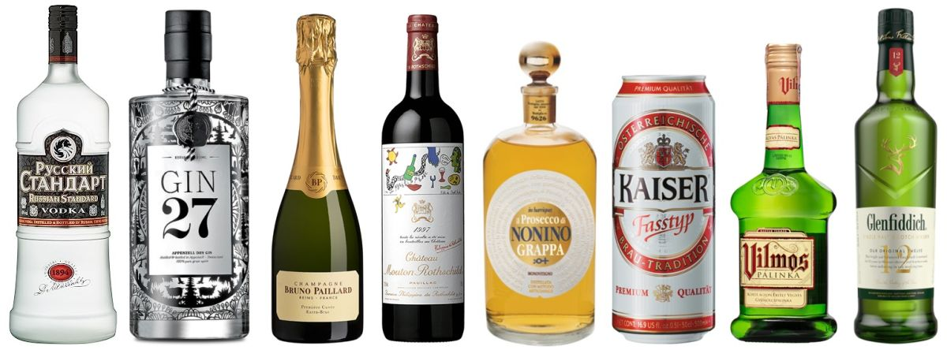
Measuring market concentration: What is a market?
Product definition

Slide 29
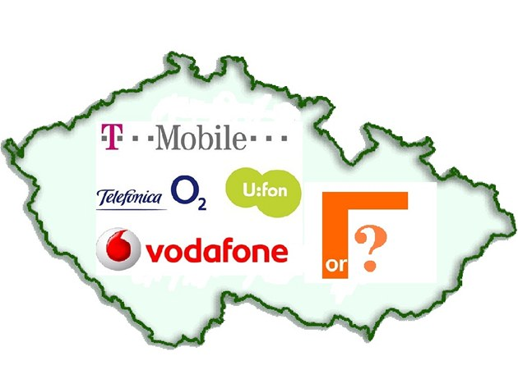
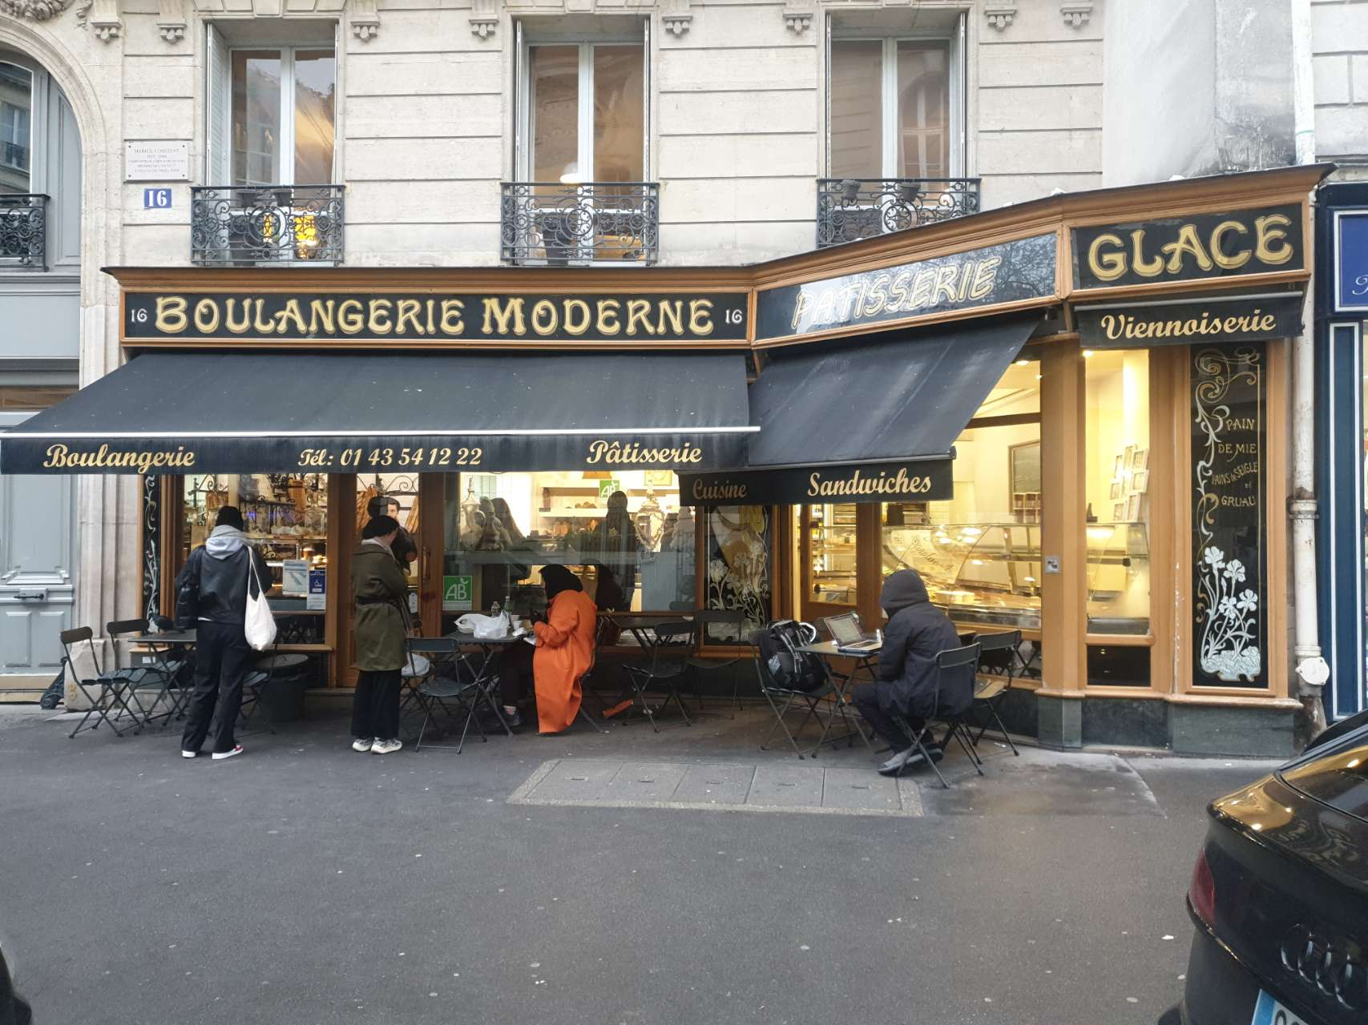
Measuring market concentration: What is a market?
Geographical definition
International
National
Local

Slide 30
Measuring market concentration: What is a market?
Key role of substitutability
Are cross-price elasticities high within a given market
Common test: If an industry given by a particular definition was monopolised, could it significantly increase the price?
Applicable to geographies as well as products
But no definite rules for defining a market
➔ Much discussion in anti-trust cases devoted to it

Slide 31
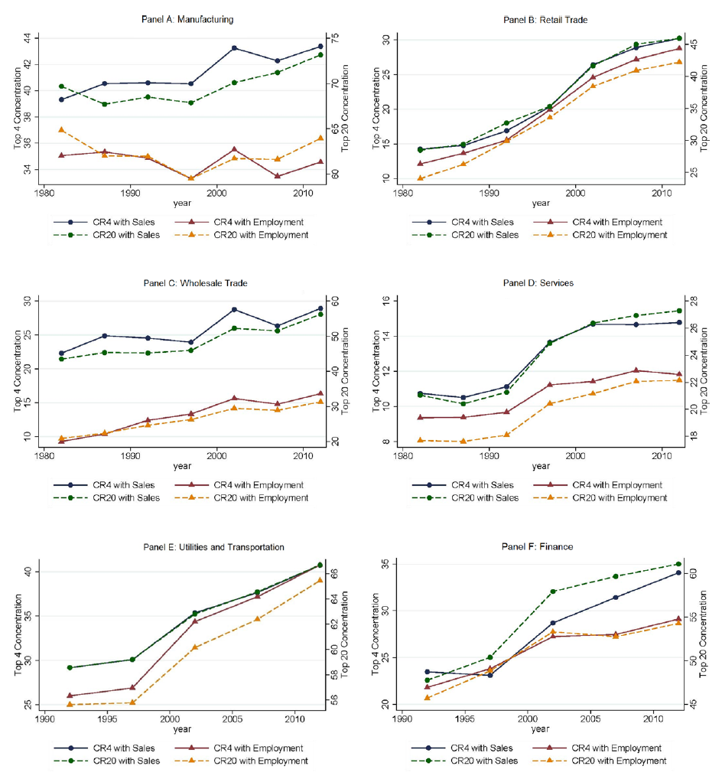
Is concentration on the rise? Autor et al. (2020)
Notes:
Many studies have documented an increase in concentration in the US

Slide 32
Is concentration on the rise? Bajgar, Berlingieri, Calligaris, Criscuolo, Timmis (2023)
Notes:
It seems the increase also applies to Europe, although probably less strongly
SUMMARY: Market concentration
Important advantage = sales data are all that is needed to computer it
BUT Two industries with a similar level of concentration can differ dramatically in terms of outcomes (e.g. price)
e.g. Betrand vs. Cournot under homogenous products and equal marginal costs
Can we measure market power directly?

Slide 33
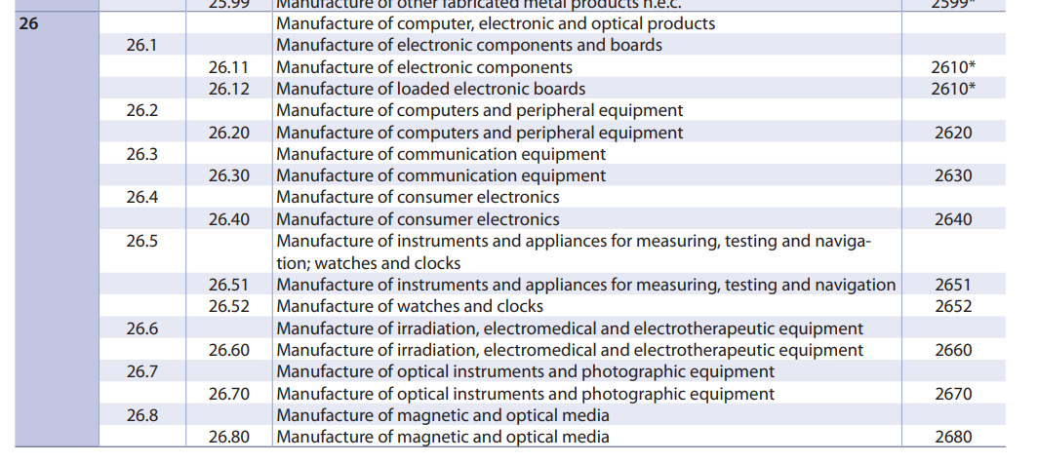
Is concentration on the rise?
The above graphs show industry concentration
Industries defined by similarity of production process rather than substitutability

Slide 34
Is concentration on the rise?
Alternative approaches
Affeldt et al. (2021)
Look at markets defined in mergers scrutinised by the European Commission
Also find an increase in concentration over time (but with a lot of heterogeneity)
Hoberg and Phillips (2016)
Text-based analysis of products referred to in companies‘ 10-K filings
Define a time-varying network of firms based on the similarity of their product descriptions
Captures the intensity of competition
Varies over time

Slide 35
Marketpower with other oligopoly models
With Cournot, market power nicely inversely related to the number of firms
But what about Bertrand model?
Or the Stackelberg model?
And what about markets with free entry?

Slide 36
Market power in Bertrand oligopoly
Assume
2 firms
Price competition
Homogeneous products
Homogeneous marginal costs
Firms split the market equally
What will be the market shares of 2 firms that split the output equally?
What will be the markups?
How does this compare with the Cournot model?

Slide 37

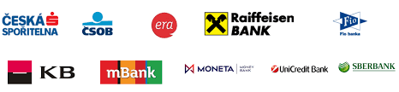
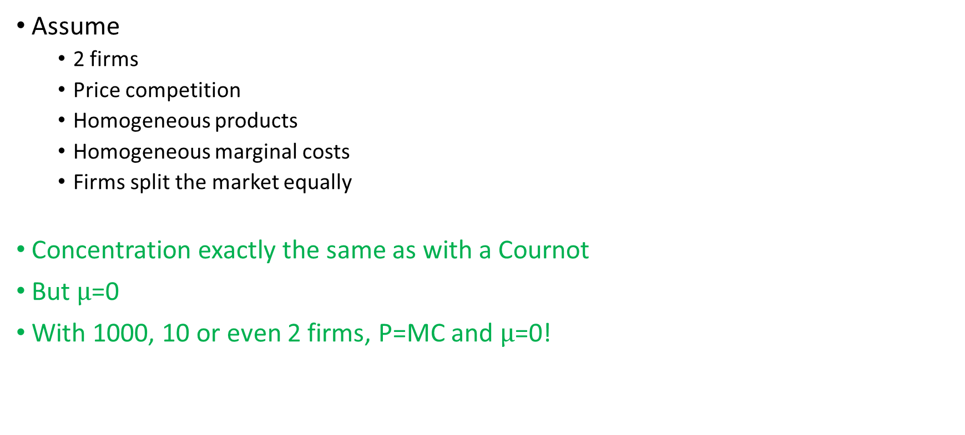
Market power in Bertrand oligopoly
Assume
2 firms
Price competition
Homogeneous products
Homogeneous marginal costs
Firms split the market equally
Concentration exactly the same as with a Cournot
But $μ$=0
With 1000, 10 or even 2 firms, P=MC and $μ$=0!

Slide 38
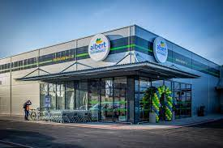
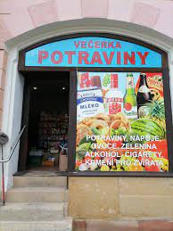
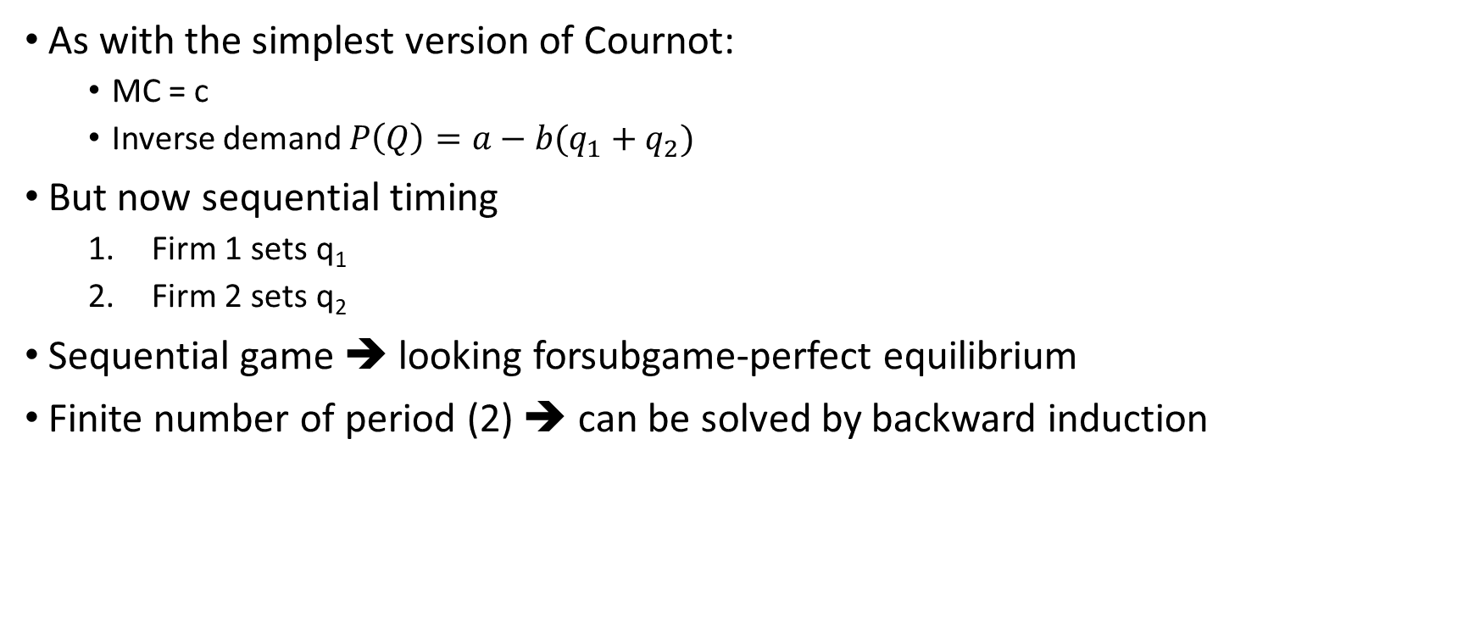
Market power in Stackelberg oligopoly
As with the simplest version of Cournot:
MC = c
Inverse demand $P\left(Q\right)=a−b(q_{1}+q_{2})$
But now sequential timing
Firm 1 sets q₁
Firm 2 sets q₂
Sequential game ➔ looking forsubgame-perfect equilibrium
Finite number of period (2) ➔ can be solved by backward induction

Slide 39
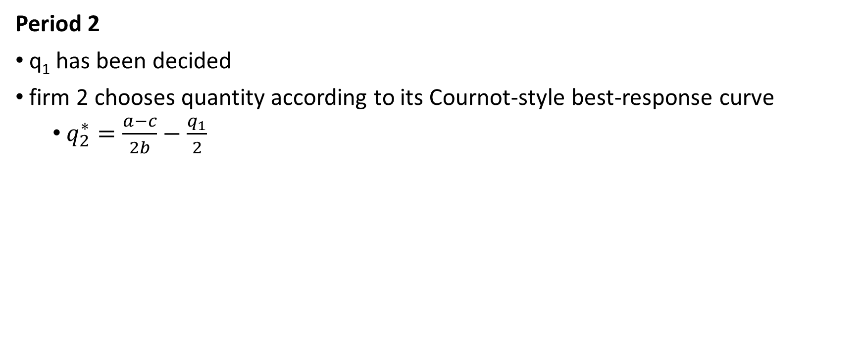
Sequential quantity competition (Stackelberg)
Period 2
q₁ has been decided
firm 2 chooses quantity according to its Cournot-style best-response curve
$q_{2}^{∗}=\frac{a−c}{2b}−\frac{q_{1}}{2}$

Slide 40
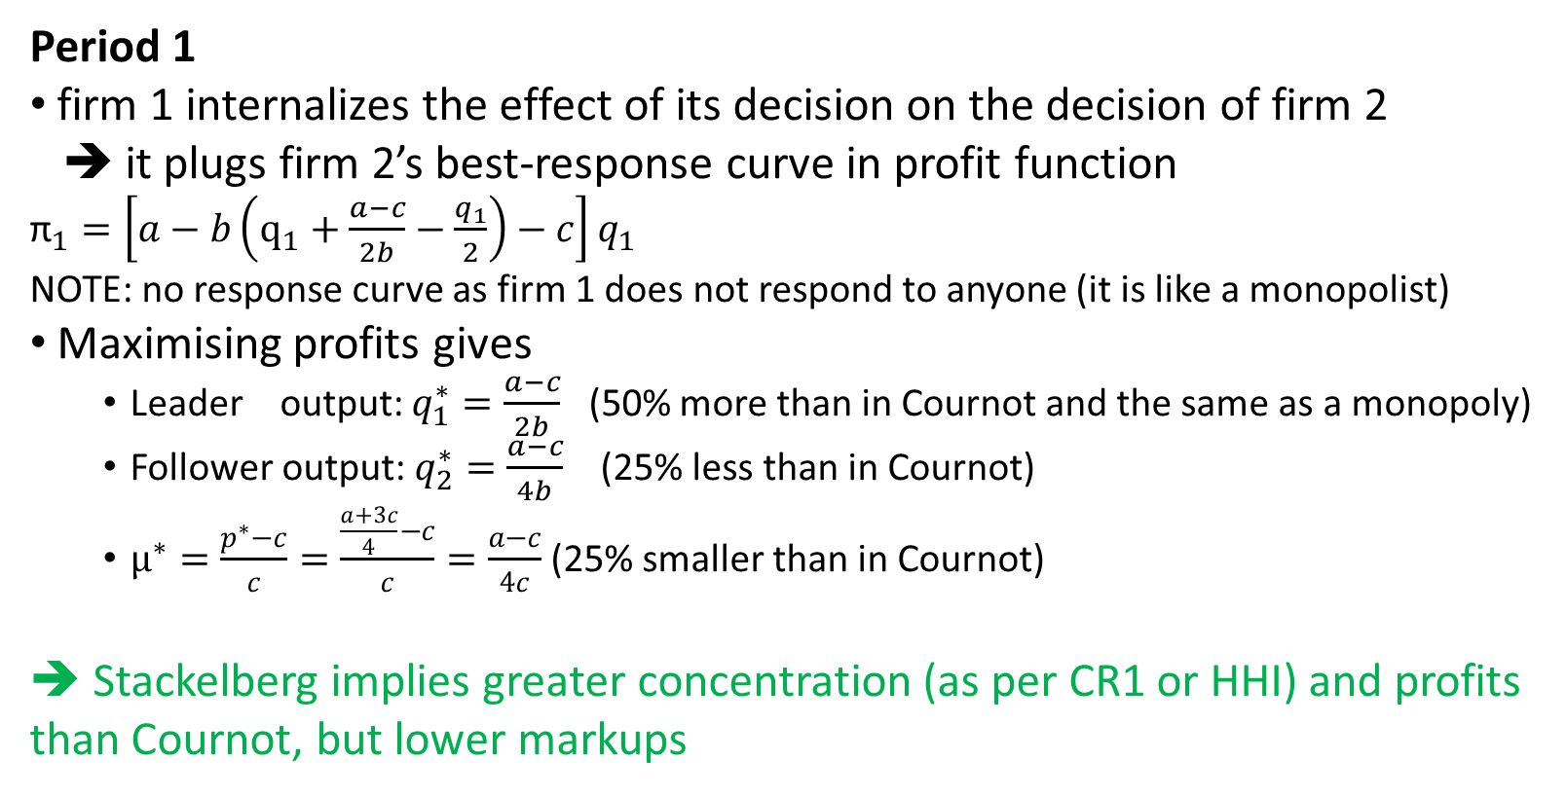
Sequential quantity competition (Stackelberg)
Period 1
firm 1 internalizes the effect of its decision on the decision of firm 2
➔ it plugs firm 2’s best-response curve in profit function
${\text{π}}_{1}=\left[a−b\left({\text{q}}_{1}+\frac{a−c}{2b}−\frac{q_{1}}{2}\right)−c\right]q_{1}$
NOTE: no response curve as firm 1 does not respond to anyone (it is like a monopolist)
Maximising profits gives
Leader output: $q_{1}^{∗}=\frac{a−c}{2b}$ (50% more than in Cournot and the same as a monopoly)
Follower output: $q_{2}^{∗}=\frac{a−c}{4b}$ (25% less than in Cournot)
$μ^{∗}=\frac{p^{∗}−c}{c}=\frac{\frac{a+3c}{4}−c}{c}=\frac{a−c}{4c}$ (25% smaller than in Cournot)
➔ Stackelberg implies greater concentration (as per CR1 or HHI) and profits than Cournot, but lower markups

Slide 41
Market power and free entry
So far, we have assumed N fixed (or implicitly entry costs e = ∞)
In many markets, entry (and exit) are common and important
Can firms have market power when entry is possible?
Is entry always a good thing?

Slide 42
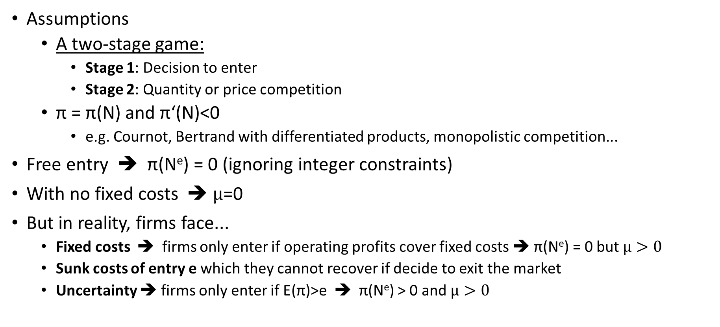
Market power and entry
Assumptions
A two-stage game:
Stage 1: Decision to enter
Stage 2: Quantity or price competition
π = π(N) and π‘(N)<0
e.g. Cournot, Bertrand with differentiated products, monopolistic competition...
Free entry ➔ π(N^{e}) = 0 (ignoring integer constraints)
With no fixed costs ➔ $μ$=0
But in reality, firms face...
Fixed costs ➔ firms only enter if operating profits cover fixed costs ➔ π(N^{e}) = 0 but $μ>0$
Sunk costs of entry e which they cannot recover if decide to exit the market
Uncertainty ➔ firms only enter if E(π)>e ➔ π(N^{e}) > 0 and $μ>0$

Slide 43
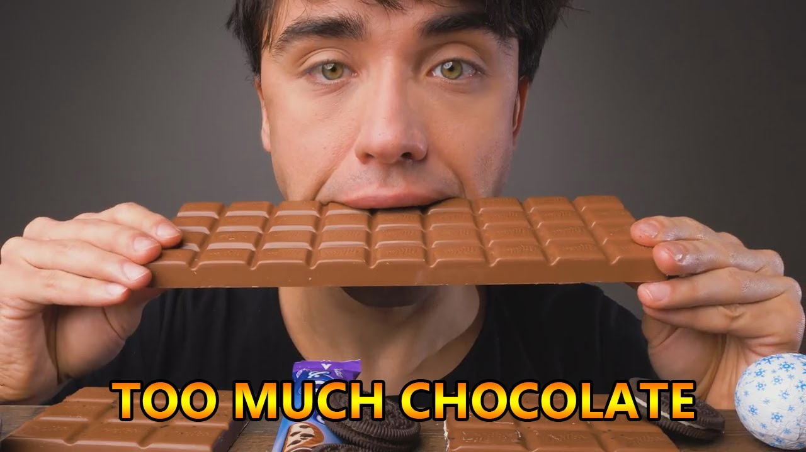
Benefits and costs of entry
Entry has benefits for welfare
Lower prices
More variety
But entry also has costs
Entry costs
Fixed costs
High marginal costs (if decreasing)
Can there be too much of a good thing? ➔ see the seminar
Cournot with free entry leads to too much entry
Intuition: entrant values the entry more than the social planner
It may be beneficial to regulate entry
e.g. auctioning of permits for broadcasting or mobile operators (although scarce spectrum also plays a role)

Slide 44
Market size and concentration
With positive fixed costs, concentration decreases in market size
For a given number of firms, greater demand increases equilibrium profits
More entry needed to bring profits to zero
But some markets show high concentration independent of market size. Why?
The answer is endogenous sunk costs (i.e. firms deciding on optimal e)
3-stage game
Firms decide whether to enter
Firms decide on a sunk-cost investment that makes them more competitive
Firms compete on quantity (for example)

Slide 45
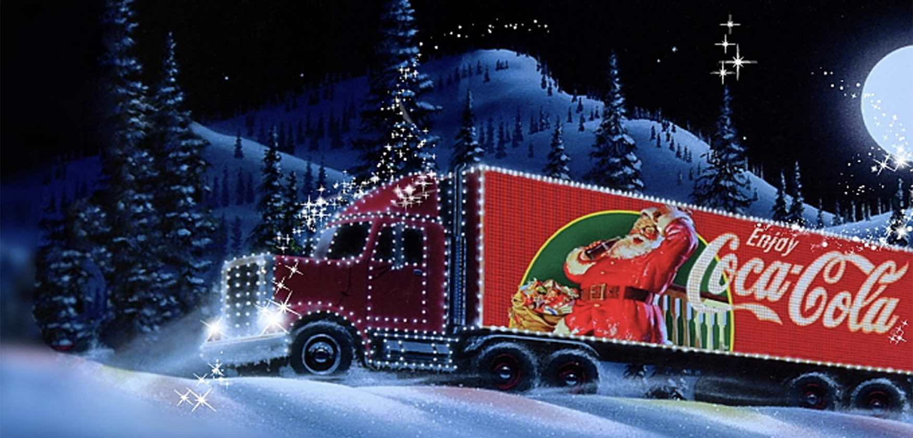

Market size and concentration
Examples of sunk costs
Advertising
R&D

Slide 46
Market size and concentration
Effect of market size with endogenous sunk costs
Market size increase
market becomes more valuable
i.e. a given market share is associated with greater profits
stronger incentive to invest in advertising/R&D to be well placed in the 3rd stage
With symmetric firms, all firms increase sunk investments and their relative position doesn‘t change
As sunk cost increase with market size, not clear that N increases
Key requirements for endogenous sunk costs
Vertical differentiation (or cost cutting)
Quality depends on fixed rather than variable costs

Slide 47
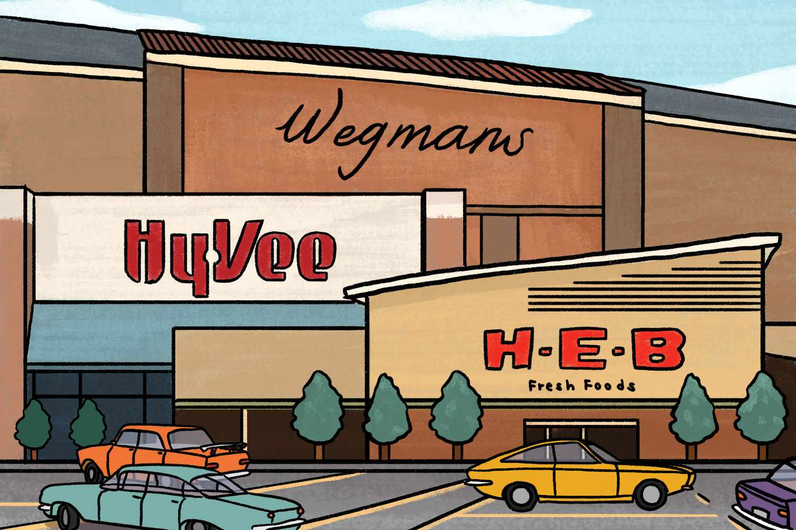
Example in US supermarkets Ellickson (2007)
US split into 51 geographic markets defined by distribution centers
Independent of market size, 4-6 major supermarket chains per market. Why?
Supermarket chains undergo sunk costs to increase product variety
Larger markets associated with greater sunk costs due to
More store space
More advanced distribution systems
Logistical software
Optical scanners
Specialised sorting equipment
Customers in larger markets
Do not have more choice in terms of different chains
But have a much bigger choice of products within each chain

Slide 48
Market power in market structure: summary
Concentration can be a misleading indicator of market power if, e.g.,
Firms compete in prices
Some firms move before others
Entry costs are endogenous
➔ With different types of competition, the same market structure can lead to very different conduct and performance!
➔ Modern IO went away from the S-C-M paradigm and instead tries to model the specific competition dynamics of a given market

Slide 49
What is market power?
How is it related to market structure
What are its sources?
How can we measure it?
Is it on the rise?

Slide 50
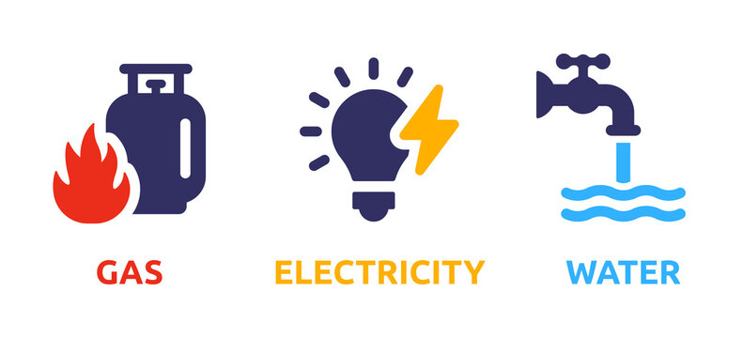
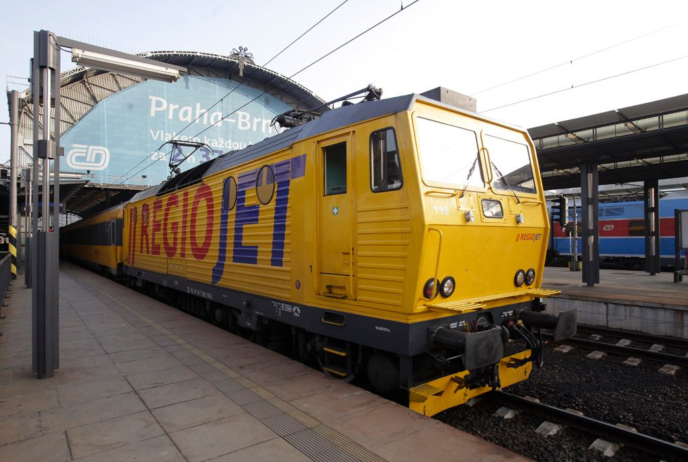
Which market features give rise to market power?
High fixed costs ➔ a natural oligopoly

Slide 51

Which market features give rise to market power?
Administratively limited number of competitors ➔ administrative oligopoly

Slide 52
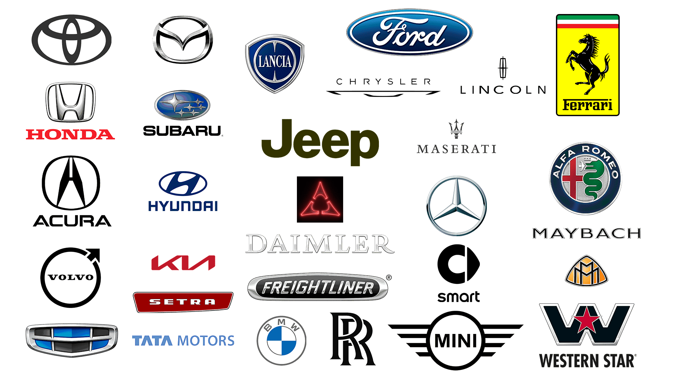
Which market features give rise to market power?
Product differentiation

Slide 53
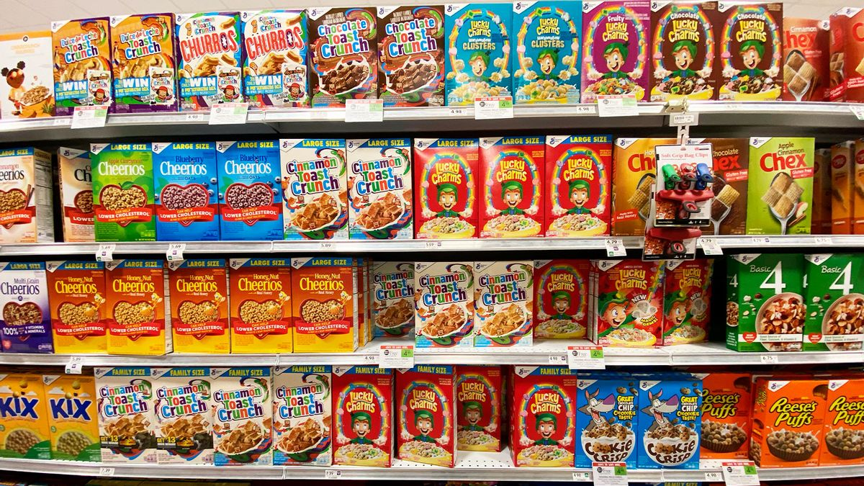
Sources of market power matter Nevo (Econometrica, 2001)
„Measuring market power in the ready-to-eat cereal industry“
Industry characterised by
High concentration
High markups
Large advertising expenditure
Frequent introduction of new products
Earlier research concluded this was a classic example of a market with near-collusive pricing together with intense non-price competition
The paper estimates that the high markups are due to
Product differentiation
Multiproduct firm pricing
No evidence for collusion ➔ No need for antitrust intervention

Slide 54

Which market features give rise to market power?
Brand

Slide 55
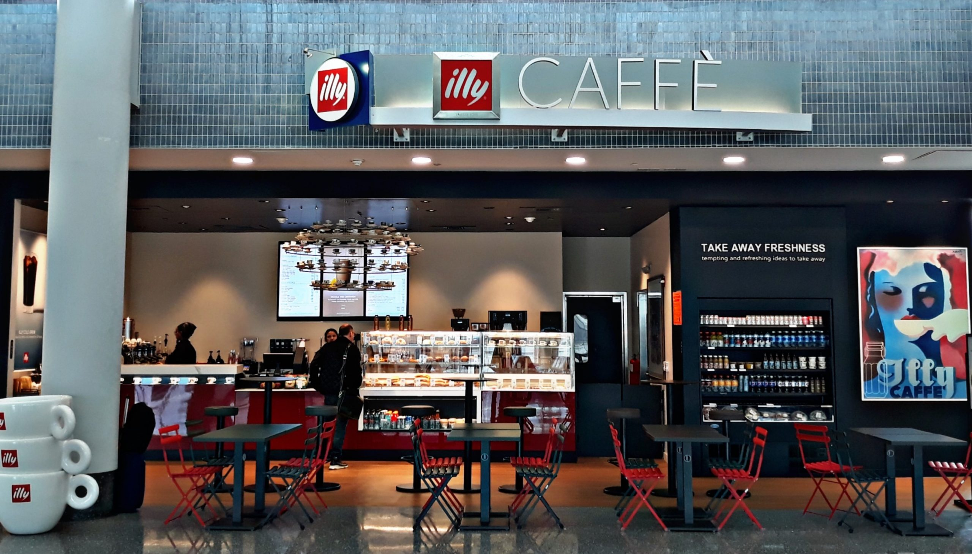
Which market features give rise to market power?
Location

Slide 56
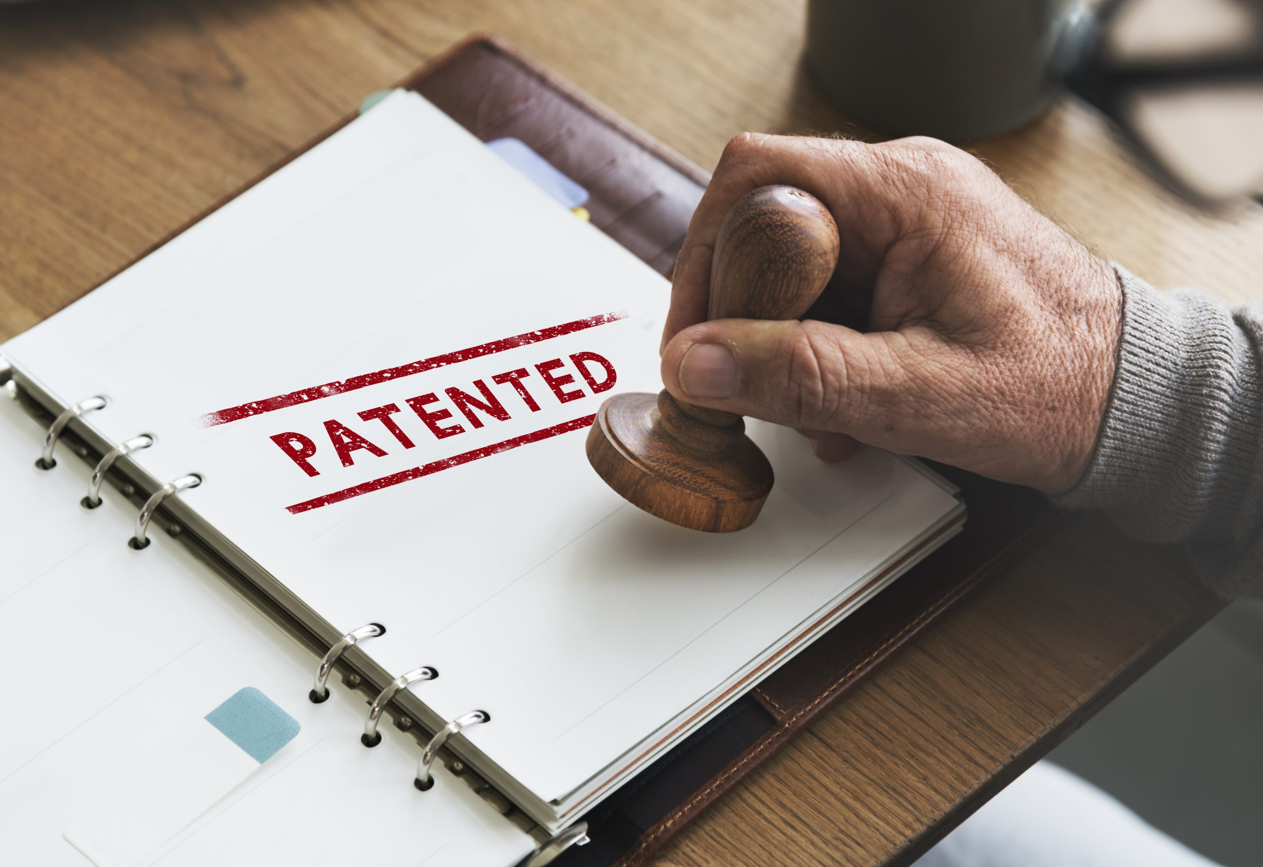
Which market features give rise to market power?
Intellectural property protection (e.g. patents)

Slide 57


Which market features give rise to market power?
Network effects

Slide 58
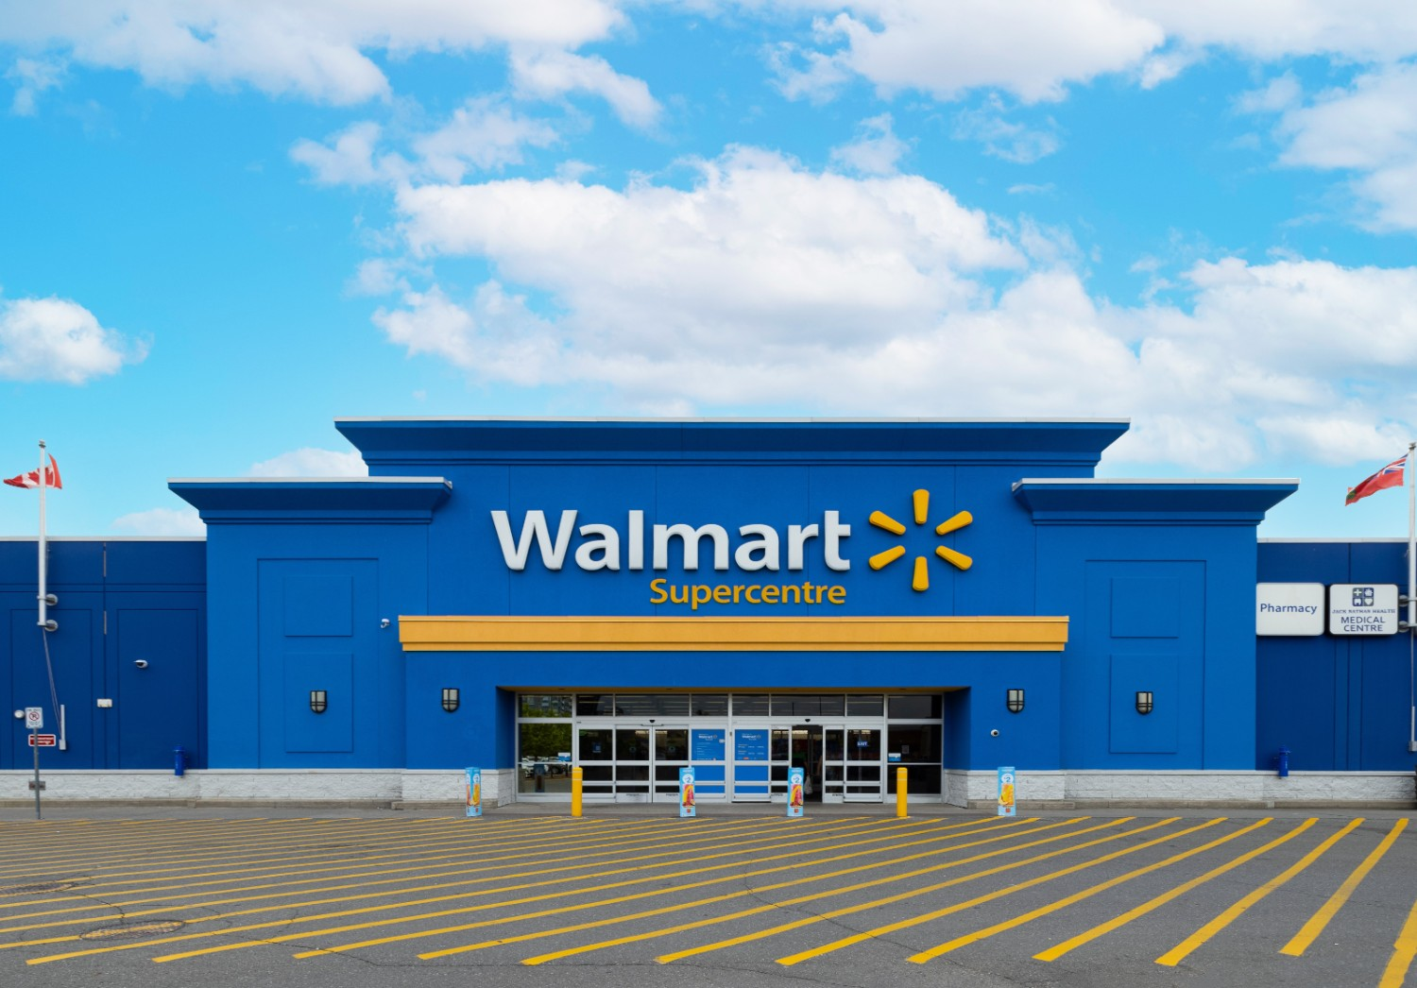
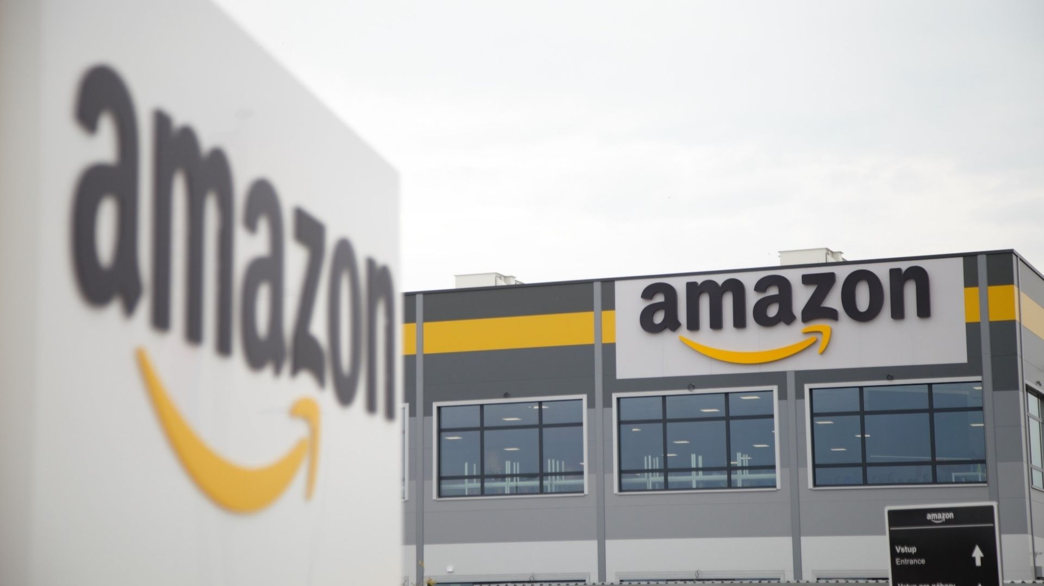
Which market features give rise to market power?
High efficiency / low costs

Slide 59
Industrial revolution in services? Hsieh, Rossi-Hansberg (NBER 2021)
Focus on service industries supplied locally (e.g. restaurants)
Local markets increasingly supplied by chains, i.e. firms operating in many other local markets
the rise in concentration by services, wholesale and retail
the concentration driven by adding locations
➔ increasing national concentration but decreasing local concentration
industry employment increasing ➔ consistent with increasing productivity
Driven by ICT technologies and new management practices
These allow fixed-cost investments that cuts marginal costs (or increases quality)
Only the top firms able to pay the fixed cost
The top firms specialise in sectors where the „industrial revolution in services“ is under way
In Czechia, notice the chainification of restaurants, pharmacies, drugstores...

Slide 60
Industrial revolution in services? Hsieh, Rossi-Hansberg (NBER 2021)
Example: How the Cheesecake Factory brought chain production to complicated sit-down meals:
technologies that determine
food purchases for each restaurant and each day
optimal staffing
process for introducting new items on the menu
a centralized “kitchen” in Calabasas, CA (their “R&D facility”) where top cooks cull ideas for new reproducible, appealing, and affordable dishes
they teach the new recipes to the kitchen managers of each restaurant at a bi-annual meeting
the kitchen managers follow a procedure to teach the new recipes to the cooks in each restaurant
7 weeks from when managers arrive at central kitchen to when new dishes are put on the menu

Slide 61
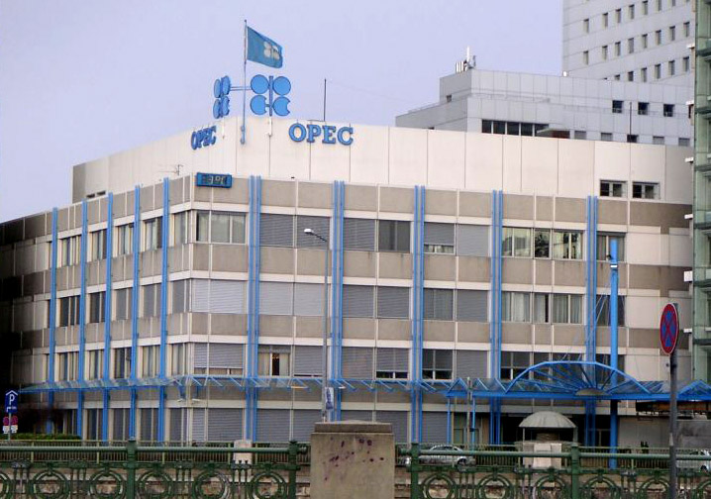
Which market features give rise to market power?
Collusion

Slide 62
What is market power?
How is it related to market structure
What are its sources?
How can we measure it?
Is it on the rise?

Slide 63
Measuring market power directly
Concentration can be a misleading indicator of market power
Ultimately, there is nothing wrong with high concentration per se
What we really care about is low prices, product quality, investment, innovation, income distribution...
Can we instead measure market power directly?

Slide 64

Markup estimation De Loecker & Warzynski, AER 2012
Based on cost minimisation, show that markups can be calculated as
$\text{μ}\text{=}\frac{\text{α}}{s^{X}}−1$, where
$s^{X}$ is a firm‘s expenditure on intermediate input X
$\text{α}$ is the elasticity of the firm‘s output with respect to input X
$s^{X}$ is observed in financial statements and $\text{α}$ can be estimated (under assumptions)
A key assumption:
the input for which we do the exercise is freely variable
this is not true for capital and may not be true for labour
applied work often uses intermediate inputs, materials, energy...

Slide 65
What is market power?
How is it related to market structure
What are its sources?
How can we measure it?
Is it on the rise?

Slide 66
Markups have been increasing in the US De Loecker, Eeckhout & Unger, QJE 2020
Notes:
A paper recently published in one of the most prestigious economics journals shows that markups of publicly traded US firms have substantially increased from 1980s
While the weighted average markup was about 20% in 1980s, it is about 60% today

Slide 67
The increase driven by the top of the distribution De Loecker, Eeckhout & Unger, QJE 2020
Notes:
The „typical“ (median) markup has not changed, but more firms have very high markups now

Slide 68
Reallocation important De Loecker, Eeckhout & Unger, QJE 2020
Notes:
The increase in markups has been driven by
growth of markups within firms
new firms that have high markups
reallocation of revenues to high-markup firms
The reallocation was most important, accounting for about 2/3 of the total increase

Slide 69
Markups also increased outside US De Loecker & Eeckhout, WP 2021

Slide 70
Increase in concentration and markups
Reasons for the observed trends are an area of active research
Increase in overheads?
note that markups are defined as price relative to marginal costs
profits also depend on fixed costs, i.e. overheads
if cost-structure changes, firms might need higher markups to cover higher overheads
overheads increased but less than markups
➔ overheads seem to be a part of the explanation but not a full explanation
➔ profits also increased
Weakening competition?
Strengthening competition? (!)
remember that most of the increase comes from reallocation towards high-markup firms
high-markup firms might also be highly productive, high-quality, innovative firms
globalization (particularly in manufacturing) or technological change (e.g. in tech, retail) might facilitate reallocation of market shares to such firms (winner-take-all dynamics)
Autor, Dorn, Katz, Patterson and Reenen (QJE 2020) document that concentrating industries saw more productivity and innovation growth
Notes:
The causes of these trends are subject to active research
Increase in overheads
markups defined as price relative to marginal costs
profits also depend on fixed costs, i.e. overheads
if cost-structure changes, firms might need higher markups to cover higher overheads
overheads increased but less than markups
➔ overheads seem to be a part of the explanation but not a full explanation
➔ profits also increased
Weakening competition
Strengthening competition (!)
remember that most of the increase comes from reallocation towards high-markup firms
high-markup firms might also be highly productive, high-quality, innovative firms
globalization (particularly in manufacturing) or technological change (e.g. in tech, retail) might facilitate reallocation of market shares to such firms (winner-take-all dynamics)
Autor, Dorn, Katz, Patterson and Reenen (QJE 2020) document that concentrating industries saw more productivity and innovation growth

Slide 71

Monopsony and labour market market power Yeh et al. (AER, 2022)
Labour markets often considered competitive
But with limited labour mobility and substitutability between professions, employers can have market power in local labour markets
➔ Lower wages („markdowns“)

Slide 72
What is market power?
What is the relationship between market power and market concentration in the Cournot oligopoly?
Is the same true also in other market settings?
What are the advantages and disadvantages of concentration as a measure of market power?
What questions do you have?

Slide 73
Exercise: Price or quantity competition?
Is each market better described as quantity or price competition?
Food in supermarkets
Crude oil
Mobile phone apps
Flights
Restaurant meals
Cars
Traditional taxi
Uber/Lyft
Notes:
Food in supermarkets – price competition
Crude oil – quantity competition
Mobile phone apps – price competition
Flights – quantity competition
Restaurant meals – price competition
Cars – normally price competition, but now it can be seen as quantity competition
Traditional taxi – price
Uber/Lyft – quantity

Slide 74
Exercise: Stackelberg
P = 200 – q₁ – q₂
MC=c=60
Derive the equation for follower‘s response and draw it on a graph.
Determine equilibrium output, price and markups in a sequential game
How would the results change in case of a Cournot competition? Who would gain and who would lose?
Compare the firms‘ outputs to those of a monopoly
Calculate concentration (CR1, HHI) in the Stackelberg and Cournot case

Slide 75
Exercise: price competition with capacity constraints
Players: Two firms
Homogenous products
Capacity constrained to 3
MC = 0
Action set: prices p₁ and p₂
Market demand Q = 9 - P
Show that p₁=p₂=3 is a Nash equilibrium

Slide 76
Exercise: Cournot and the number of firms
Inverse demand P(Q) = 100 – Q
Total costs TC(q) = 10 + 20q.
A large number of potential entrants playing the following two-stage game:
1. Firms simultaneously decide whether to enter or not.
2. Firms that did enter in the previous stage set their quantities simultaneously.
If a firm does not enter, then it gets a profit of zero.
Assume N firms entered in stage 1. Find the equilibrium of the quantity-setting game (stage 2).
Solve for the equilibrium number of firms, given integer constraints (N is an integer).
Use your answer to (a) to compute consumer surplus, producer surplus and social welfare as a function of N.
Assume a social planner controls entry decisions and maximizes social welfare. Solve for the optimal number of firms (again with an integer constraint), and compare it to the equilibrium number of firms you obtained in question (b). Explain the intuition.

